Slide 1

PPS: Pose-to-Pose Skinning of Animated Meshes
Andreas A. Vasilakis
abasilak@iti.gr
Information Technologies Institute
Centre for Research & Technology Hellas
Athens, Greece
Ioannis Fudos George Antonopoulos
fudos@cs.uoi.gr gantonop@cs.uoi.gr
Dept. of Computer Science & Engineering
University of Ioannina
Ioannina, Greece
Notes:
Thanks for the introduction, My name is Andreas Vasilakis and I’ll talk about our work on pose-to-pose skinning of animated meshes.

Slide 2
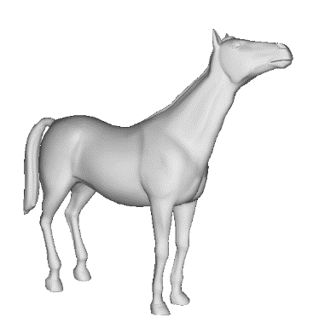
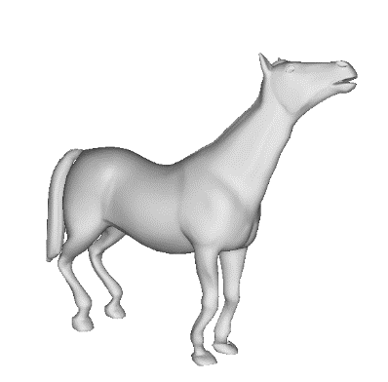
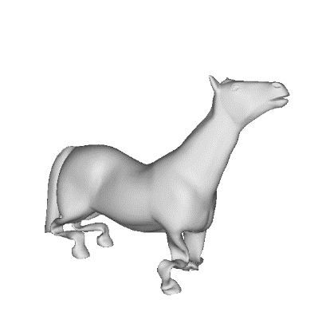
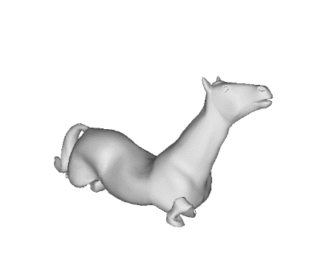
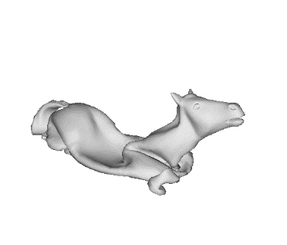

Animation Compression
[Problem]: The process of reducing the size of an animation file.
Pose 1
Pose 2
Pose 3
Pose 4
Pose 5
Notes:
In computer graphics, animation compression is essential for efficient storage, transmission and reproduction of animated meshes,
where a mesh animation consists of a consecutive number of frames or poses.

Slide 3
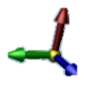
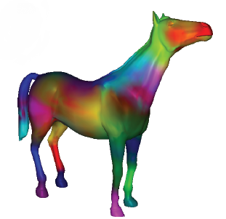
Animation Compression
[Problem]: The process of reducing the size of an animation file.
Pose 1
Pose 2
Pose 3
Pose 4
Pose 5
[Solution]: Perform weighted skinning transformations.
Each pose
Rest-pose
(fixed)
Bone weights
(fixed)
Bone transformations
(per pose)
Notes:
Previous work has presented efficient techniques for compression using weighted skinning transformations to derive the animated mesh from a single reference pose.
The bone transformations are typically the only quantity that is allowed to vary during the course of an animation.

Slide 4
Skinning Mesh Animation Problem
[Iterative optimization of skinning parameters]
Each pose
Rest-pose (3,…)
Weights (2,…)
Transformations (1,4,…)
Notes:
More or less, previous work focus on producing high-quality approximation results by optimizing all of the skinning parameters in an iterative manner.

Slide 5
Skinning Mesh Animation Problem
[Iterative optimization of skinning parameters]
Each pose
Rest-pose
Bone weights
Bone transformations
[Limitations]
Streaming ??
Editing ??
Notes:
However, since the bone transformations describe the transition from the rest-pose to an arbitrary pose of the animation sequence,
these methods are limited to support efficient compression rates.

Slide 6
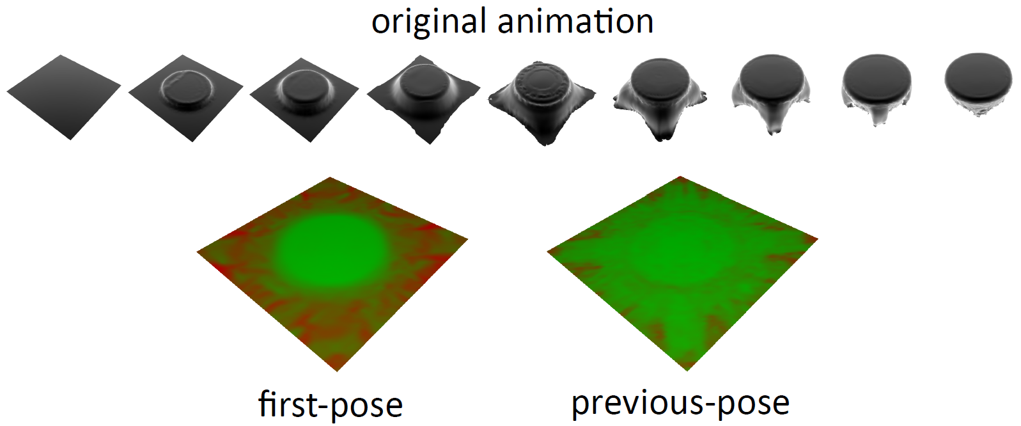
Motivation for pose-to-pose skinning
[Question] Why the first-pose is used as the rest-pose??
Notes:
So the motivation behind this work raised by the observation that larger deformation variations occur the farther a pose deviates from the rest-pose shape
due to the insufficient degrees of freedom in the skinning algorithms.

Slide 7
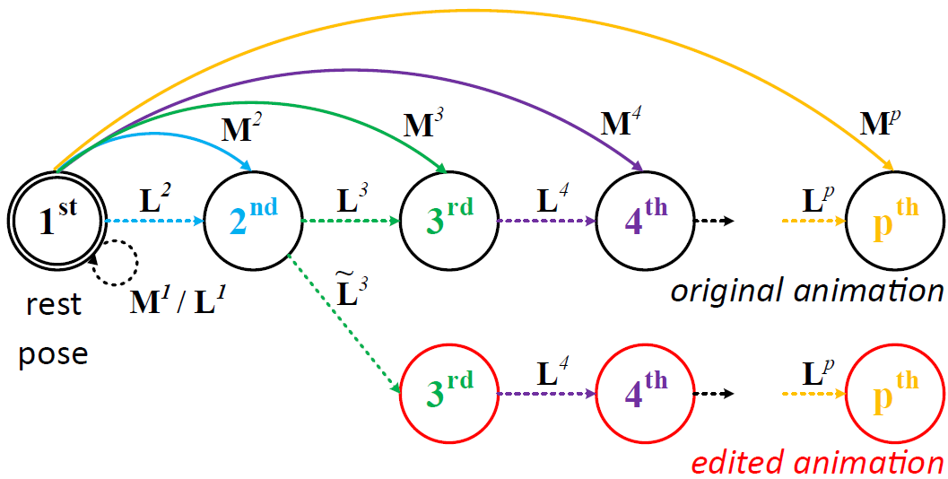
Pose-to-pose skinning (PPS)
[Advantages]
Temporal Coherence
Arbitrary Pose Editing
Notes:
To this end, we introduce a pose-to-pose skinning technique that exploits temporal coherence.
Contrary to previous works,
1) the transformations are applied so that a new pose is derived by
deforming the geometry of the previous pose.
2) Our method can handle editing of any pose in the skinned sequence with the extra cost of recomputing the transformation towards the newly edited pose from the previous one.

Slide 8
Pose-to-pose skinning (PPS)
[Advantages]
Temporal Coherence
Arbitrary Pose Editing
GPU-acceleration
Iterative optimization
Notes:
3) Although skinning is performed between successive poses, hardware accelerated rendering is also possible by converting our method from
an arbitrary- to a rest-pose reproduction scheme.
4) Finally, similar to prior art, PPS can support vertex and weight correction techniques in order to reduce the skinning error without increasing the storage demands.
As you can see, I have omitted the details due to time constraints…audience is referred to the original paper.

Slide 9
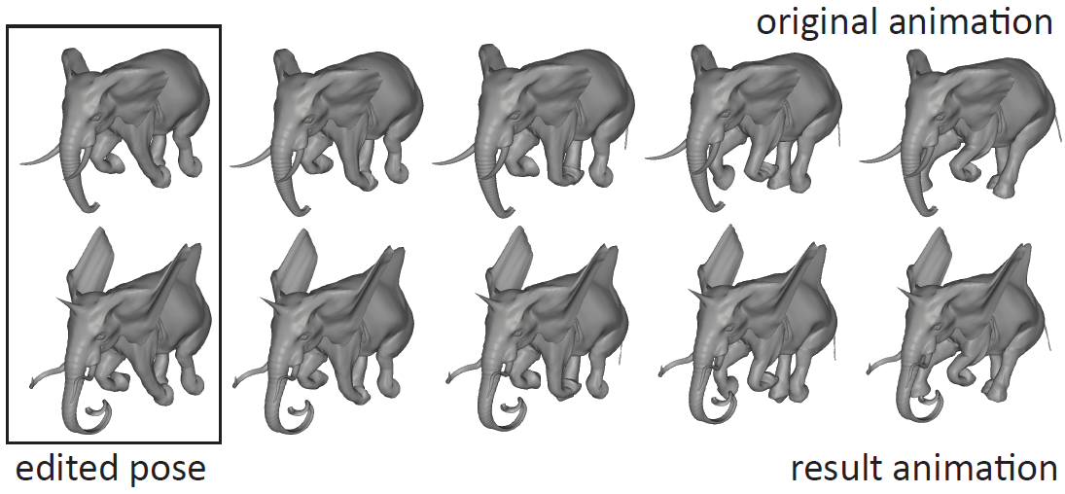
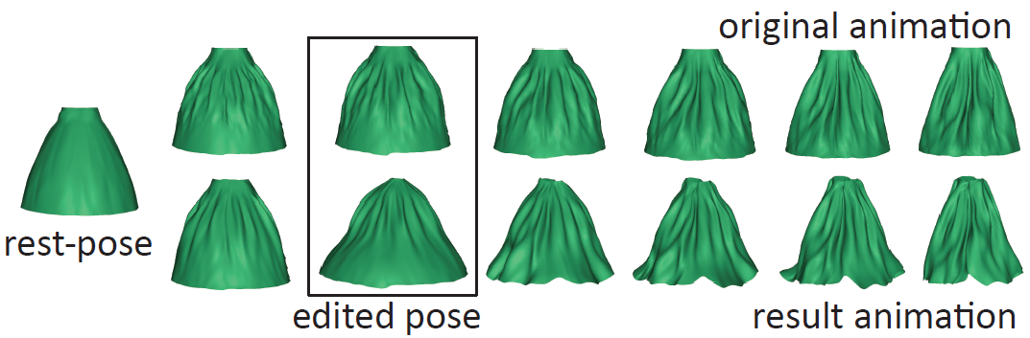
Results - Arbitrary Pose Editing
[Rest-pose]
[Arbitrary-pose]
Notes:
So, lets see some editing results…
Top Figure demonstrates how editing is propagated to the consecutive poses of a skeletal-based animation after densely manipulating the leftmost one.
While Bottom Figure illustrates the result animation after editing the third pose of a highly-deformable skirt animation.

Slide 10
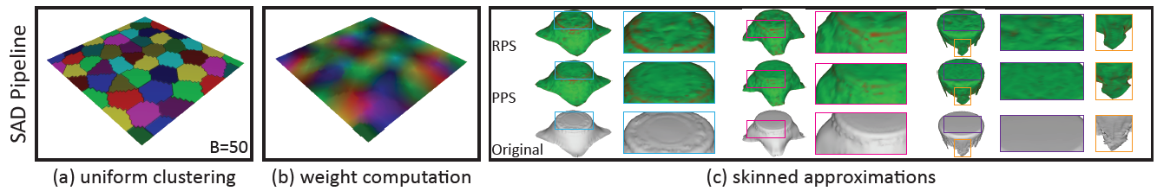
Results - Approximation
SAD¹: suitable for streaming (non-iterative)
¹ Kavan et al. - Skinning arbitrary deformations [I3D’07]
Notes:
We compare our PPS scheme against two RPS-based frameworks under a variety of animation sequences
using as quality criterion the widely-accepted KG approximation error metric.
SAD is widely suitable for streaming of animation sequences, since it does not make any assumptions about the input animation
ensuring that the overall deformation is reasonably approximated. This pipeline consists of three core stages:
A uniform clustering is initially employed to 2. compute the per-vertex weight influences and finally 3. optimizes their skinned transformations
The heat-map visualization, used to highlight the errors from the original poses, shows the superiority of PPS compared to RPS.
Similar results are also observed in the bottom Table…

Slide 11
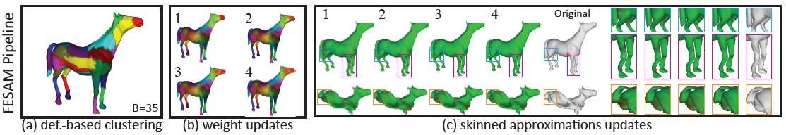
Results - Approximation
FESAM²: suitable for compression (iterative)
² Kavan et al. - Fast and efficient skinning of animated meshes [CGF’10]
Notes:
FESAM is an algorithm that produces more accurate approximations than SAD by optimizing all of the skinning parameters iteratively:
Bone transformations; vertex weights; and rest pose positions.
A deformation-aware region-growing clustering method is initially used for distributing bones and determining the weights per vertex.
While the deformation-based clustering method produces coarse weight distribution and skinned outputs, this is fixed in the consecutive optimization steps.
Note that PPS requires more optimization iterations compared to the RPS to achieve convergence (orange VS blue lines).
But this is reasonable since PPS relies on a suboptimal weight correction optimization step (you can see paper for further details)

Slide 12
Conclusions
Pose-to-pose skinning of animated meshes
Temporal coherence
Approximation error reduction
Editing of arbitrary poses
RPS reproduction scheme (GPU-accelerated)
Cannot be implemented in parallel
Suboptimal weight correction technique
Notes:
We have presented PPS, a pose-to-pose approach to skinning animated meshes by observing that only small deformation variations will normally occur between consecutive poses.
The transformations are applied so that a new pose is derived by deforming the geometry of the previous pose, thus maintaining temporal coherence in the parameter space, reducing approximation error and facilitating forward propagated editing of arbitrary poses
Last but not least, a reproduction scheme from the rest-pose to an arbitrary pose can also be derived.
On the other hand, our method cannot be implemented in parallel as well our weight correction technique is suboptimal when compared to the RPS method.

Slide 13

Thank You – Questions ???

